Slide 1
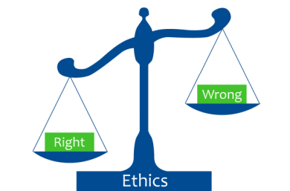
Intro in Medical Ethics
What is medical ethics
Basic principles
Controversial issues
Ethics for clinical technologists
17.6.0 Intro in Medical Ethics
Unit C 17.6 Trends in Medical Research Ethics
Module 279-17-C Regulations, Standards and Ethics
dr. Chris R. Mol, BME, NORTEC, 2015

Slide 2
What is (Medical) Ethics ?
Ethics or moral philosophy is the branch of philosophy that deals with concepts of right and wrong conduct. It investigates the questions "What is the best way for people to live?" and "What actions are right or wrong in particular circumstances?" Ethics seeks to define concepts such as good and evil, right and wrong, virtue and vice, justice and crime.
Ethics guides (professional) behaviour in case there are no regulations or standards.
Medical ethics is a system of moral principles that apply
values and judgments to the practice of medicine.
Bio ethics is the philosophical study of the ethical controversies brought about by advances in biology and medicine.
… there are many alternative definitions…
©
Intro Medical Ethics
dr. Chris R. Mol, BME, NORTEC, 2016

Slide 3
Moral principles in Biomedical Ethics
A common framework used in the analysis of medical ethics is the "four principles" approach.
It recognizes four basic moral principles, which are to be judged and weighed against each other, depending on the precise case. The four principles are:
Beneficence – to act in the best interest of the patient.
Non-maleficence – "first, do no harm“
Autonomy – the patient has the right to refuse or choose their treatment.
Justice – who gets what treatment (fairness and equality).
Other values that are often discussed include:
Respect for persons – the patient (and the person treating the patient) have the right to be
treated with dignity.
Truthfulness and honesty – the patient deserves to know the whole content about the illness and
treatment (including ‘informed consent’)
Values such as these do not give answers as to how to handle a particular situation, but provide a useful framework for understanding conflicts.
©
Intro Medical Ethics
dr. Chris R. Mol, BME, NORTEC, 2016

Slide 4
Beneficence: ‘doing good’
Beneficence means taking actions that serve the best interests of patients.
However, it is not always clear which practices do in fact help patients (e.g. in cases of cosmetic surgery, euthanasia, …) .
How should a physician decide about what is ‘good’ for the patient?
Understand the patient perspective
Address misunderstandings and concern
Try to persuade the patient
Negotiate a mutually acceptable plan of care
Ultimately let the patient decide
©
Intro Medical Ethics
dr. Chris R. Mol, BME, NORTEC, 2016

Slide 5
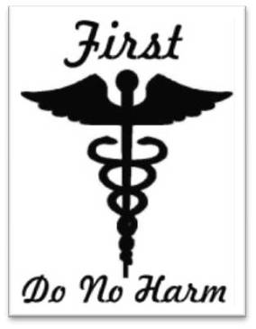
Non-maleficence: ‘first, do no harm’
Non-maleficence ‘first’ is based on the notion that it is more important not to harm than to do good. Be on the safe side!
It is important to know how likely it is that a treatment will harm a patient. So a physician should not prescribe medications (or otherwise treat the patient) unless s/he knows that the treatment is unlikely to be harmful; or at the very least, that patient under-stands the risks and benefits, and that the likely benefits outweigh the likely risks.
In practice many treatments carry some risk of harm. In some circumstances, e.g. in desperate situations where the outcome without treatment will be grave, risky treatments that stand a high chance of harming the patient will be justified, as the risk of not treating is also very likely to do harm. So the principle of non-maleficence is not absolute, and balances against the principle of beneficence (doing good), as the effects of the two principles together often give rise to a double effect.
If benefit equals harm, do not intervene
©
Intro Medical Ethics
dr. Chris R. Mol, BME, NORTEC, 2016

Slide 6
Respect for autonomy
Autonomy is where the patient has the right to refuse medical treatment or choose a medical treatment. Autonomy is the basis for the requirement of ‘informed consent’ regarding treatments.
Without the ethical principle of Autonomy, the principles of Non-Maleficence and Beneficence would lead to a paternalistic approach: the doctor decides what is ‘ethical’.
Because of this principle, physicians should disclose information and help patients deliberate.
A person's autonomy may be justifiably restricted for several reasons:
the person is incapable of making informed decisions. Respecting autonomy is less important than acting in the best interest of the patient.
individual autonomy is constrained by the needs of other individuals or society at large.
an individual is not free to act in ways that violate the autonomy of other people, harm others, or impose unfair claims on society's resources
©
Intro Medical Ethics
dr. Chris R. Mol, BME, NORTEC, 2016

Slide 7
Justice
Justice is where patients are treated impartially, without bias on account of gender, race, sexuality, wealth and etc. Justice focuses on who gets medical treatment with specific scarce medical resources.
For example, one of the first instances to allocate a scarce medical resource was in the 1960s with the availability of dialysis for people in chronic kidney failure. Since the demand exceeded the supply because dialysis was expensive and not accessible on a large scale, it meant not all people who needed it could receive it. So the principle of Justice was applied.
You are a physician working in an Intensive Care Unit with a capacity of five beds, four of which are occupied. You receive a call from Emergency where they have two patients needing ICU admission. The mother of one of those patients, whom you know, pleads with you to save her young son. The other patient, as you find out later is a foreigner with no relatives in the country. What would be the right action in this case?
How to set priorities for deciding whether we want CT scanners, dialysis equipment, dental chairs or theatre equipment ?
©
Intro Medical Ethics
dr. Chris R. Mol, BME, NORTEC, 2016

Slide 8
Respect for Persons and Confidentiality
Confidentiality is commonly applied to conversations between doctors and patients. This concept is commonly known as patient-physician privilege. Legal protections prevent physicians from revealing their discussions with patients, even under oath in court.
However, there are many exceptions to these rules. For example, many US states require physicians to report gunshot wounds to the police and impaired drivers to the Department of Motor Vehicles. Confidentiality is also challenged in cases involving the diagnosis of a sexually transmitted disease in a patient who refuses to reveal the diagnosis to a spouse, and in the termination of a pregnancy in an underage patient, without the knowledge of the patient's parents. Many states in the U.S. have laws governing parental notification in underage abortion.
Confidentiality is an important issue in primary care ethics, where physicians care for many patients from the same family and community, and where third parties often request information from the considerable medical database typically gathered in primary health care.
©
Intro Medical Ethics
dr. Chris R. Mol, BME, NORTEC, 2016

Slide 9
Truthfulness and Honesty
Truthfulness and Honesty builds on Autonomy to lead to ‘informed consent’
Informed consent refers to the idea that a person must be fully informed about and understand the potential benefits and risks of their choice of treatment. An uninformed person is at risk of mistakenly making a choice not reflective of his or her values or wishes.
The process of obtaining consent, or the specific legal requirements, will vary from place to place
Patients can elect to make their own medical decisions, or can delegate decision-making authority to another party.
If the patient is incapacitated, laws around the world designate different processes for obtaining informed consent, typically by having a person appointed by the patient or their next of kin make decisions for them. The value of informed consent is closely related to the values of autonomy and truth telling.
©
Intro Medical Ethics
dr. Chris R. Mol, BME, NORTEC, 2016

Slide 10
Conflicts between the principles
Autonomy can come into conflict with Beneficence when patients disagree with recommendations that healthcare professionals believe are in the patient's best interest.
When the patient's interests conflict with the patient's welfare, different societies settle the conflict in a wide range of manners.
In general, Western medicine defers to the wishes of a mentally competent patient to make their own decisions, even in cases where the medical team believes that they are not acting in their own best interests. However, many other societies prioritize beneficence over autonomy.
A patient in a Nursing home has no ability to find food, prepare it or bring it to her mouth, but has ability to swallow. Should she be fed?
What, if a patient does not want a treatment because of, for example, religious or cultural views? What if parents do not want such treatment for their children?
What, if the patient wants an ‘unnecessary’ treatment, as can be the case in hypochondria or with cosmetic surgery.
©
Intro Medical Ethics
dr. Chris R. Mol, BME, NORTEC, 2016

Slide 11
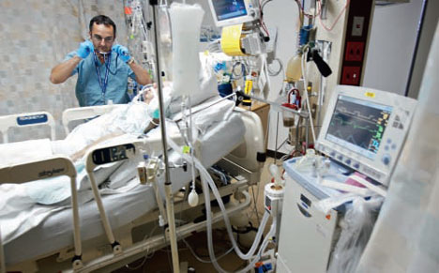
Controversial issue: Ending medical treatment
Modern technology has complicated the application of the Beneficence principle.
up to what point do you use technology (e.g. a ventilator) to keep a very ill patient alive who has massive brain damage or even no brain function left.
In some situations, it is technically possible to continue ventilating the patient for a very long time, causing the heart to continue pumping and to keep ‘the body’ alive.
The traditional criterion for death is ‘the irreparable cessation of heartbeat, respiration and blood pressure’.
These days, brain death is often considered death.
©
Changes in Research Ethics
dr. Chris R. Mol, BME, NORTEC, 2016

Slide 12
Controversial issue: Euthanasia
Due to modern healthcare, people sometimes get very diseased and demented. They can suffer a lot. Often, such persons want to die, but are not able to accomplish this themselves.
Is it ever allowed to help such a person dying ?
Passively (letting a patient die):
withdrawing life support (e.g. ventilation, intravenous feeding, medical drugs)
Actively (helping a patient to die):
giving a deadly injection or potion
If the answer is yes, under what conditions would that be?
Strict conditions in the Netherlands for active euthanasia include:
it should be requested repeatedly by the patient, unbearable suffering without end, two medical doctors, …
How about giving a terminally ill patient a dose of pain-killing morphine, which can be expected to hasten death ?
©
Changes in Research Ethics
dr. Chris R. Mol, BME, NORTEC, 2016

Slide 13
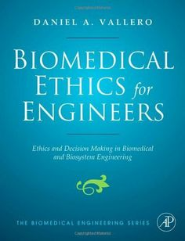
Ethics for Clinical Engineering Professionals
A lot of information can be found on the internet regarding Ethics for BioMedical Technologists and related professions. For example:
The American College of Clinical Engineering (ACCE) defines a clinical engineer as “A professional who supports and advances patient care by applying engineering and management skills to health care technology.”
ACCE amplifies this definition in its seven-point code of ethics, as follows:
Prevention of injury in the clinical environment
Accurate representation of the clinical engineer’s knowledge, level of responsibility, education, authority and experience
Revelation of conflict of interest
Protection of confidential information
Improvement of patient care delivery
Cost containment by technology utilization
Promotion of the profession of clinical engineering
“It is not ethical to allow clinical users to work with an unsafe device.”
©
Intro Medical Ethics
dr. Chris R. Mol, BME, NORTEC, 2016

Slide 14
END
The creation of this presentation was supported by a grant from THET:
see https://www.thet.org/

